Slide 1
JAVA
Collection API
- Shruti Kumari

Slide 2
Collections API
Collection represents a group of objects.
Collections framework provides a set of standard utility classes to manage collections.

Slide 3
Collection framework consists of three parts
Core Interfaces
Concrete implementation
Algorithms such as searching and sorting

Slide 4
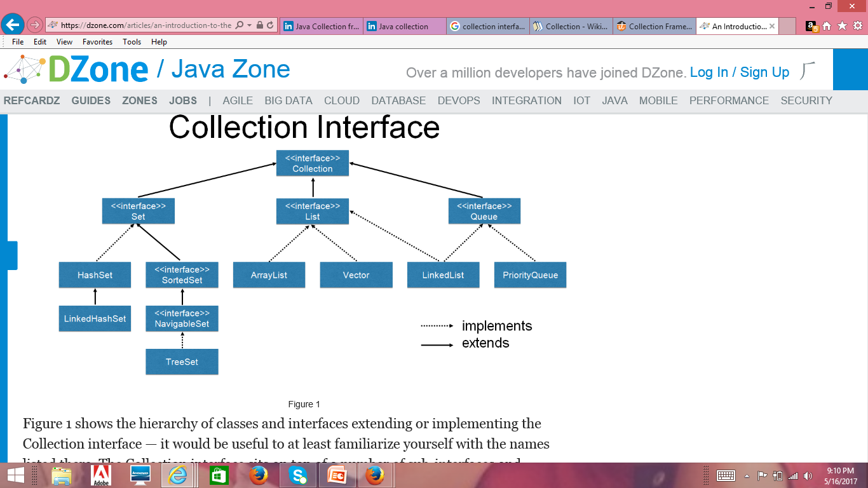
Concept of Interfaces and Implementation

Slide 5
Collection Interfaces
Collection
Set
SortedSet
List
Queue
Map
SortedMap

Slide 6
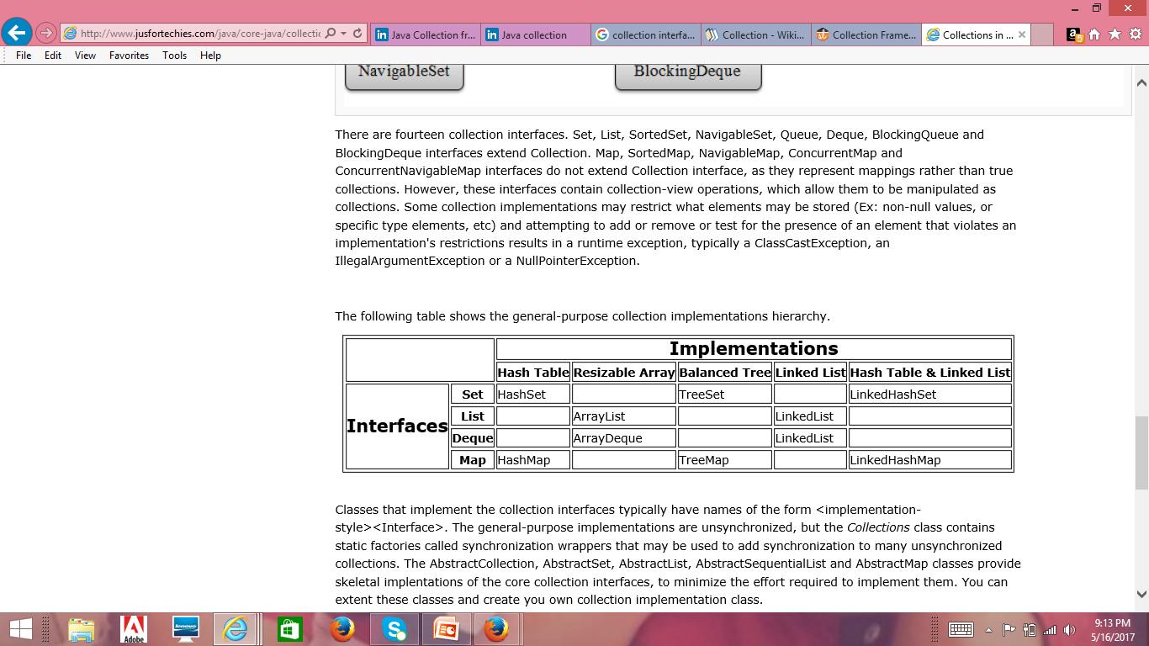
Collection Implementations

Slide 7
Collection Interface Methods
int size()
boolean isEmpty()
boolean contains (Object element)
boolean add (Object element)
boolean remove (Object element)
Iterator iterator()
boolean containsAll(Collection c)
boolean addAll(Collection c)

Slide 8
Collection Interface Methods
boolean removeAll(Collection c)
boolean retainAll(Collection c)
void clear()
object[] toArray()
object[] to Array(object a[])

Slide 9
Iterator Interface
Iterator interface provides the facility of iterating the elements in forward directions only.
Methods
boolean hasNext()
Object next()
void remove()

Slide 10
ArrayList Class
An ArrayList Class can grow dynamically.
It provides more powerful insertion and search mechanisms than arrays.
It gives faster iteration and fast random access.
It uses Ordered Collection(by index),but not Sorted.

Slide 11
HashSet Class
HashSet Class does not allow duplicates.
A HashSet is an unsorted, unordered Set.
It can be used when you want a collection with no duplicates and you do not care about the order when you iterate through it.

Slide 12
TreeSet Class
TreeSet does not allow duplicates.
It iterates in sorted order.
Sorted Collection:
By default elements will be in ascending order.
Not synchronized:
If more than one thread wants to access it at the same time, then it must be synchronized externally.

Slide 13
Comparator Interface
The java.util.Comparator interface can be used to sort the elements of an Array or a list in the required way.
It defines two methods:
int compare(Object o1,Object o2)
boolean equals(Object obj)

Slide 14
Comparable Interface
Java.util.Comparable interface imposes a total ordering on the objects of each class that implements it.
Methods defined:
public int compareTo(Object o)
compares this object with a specified object for order.

Slide 15
HashMap Class
It uses the hashcode value of an object to determine how the object should be stored in the collection.
It gives you an unsorted and unordered map.
It allows one null key and multiple null values.

Slide 16
Thank You!

